Slide 1
Random Introductory Statistics Concepts
Compiled to help with prepping for a Data Science Boot Camp

Slide 2
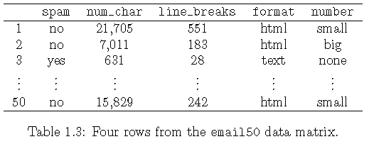
Converting Tables to Stats Terminology
Variables or Characteristics (Columns)
Observation or
Cases (Rows)

Slide 3
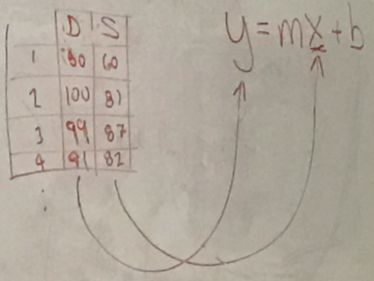
Predictors or
Explanatory Variables or
Dependent Variables
Response Variable or
Dependent Variable
Coefficients:
m = slope = rise/run
b → represents Error

Slide 4
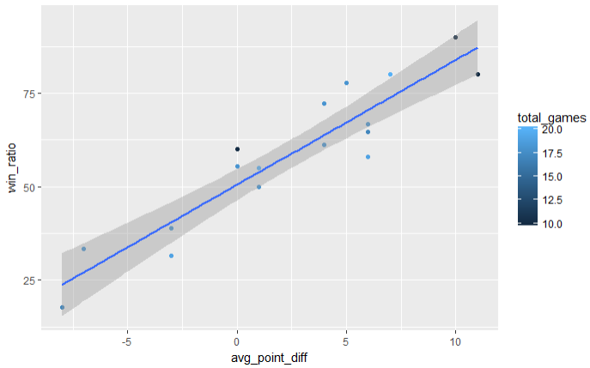
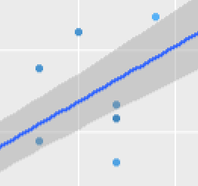
Understanding: Linear Regression Simple Linear Models
Calculating the confidence interval: Mean +/- 1.96 x sqrt(sigma) / sqrt(n)
Where n = sample size
Bootstrapping: adding noise so the model won’t be too perfect and overfit the data

Slide 5
Zooming in on The Previous Image …
Predictors: Points Making Up This Line
Confidence Interval
Residuals: distances from data points to the points on the predictor line of the model (distance from Ydatapoint to Ypredictor.
Data Points

Slide 6
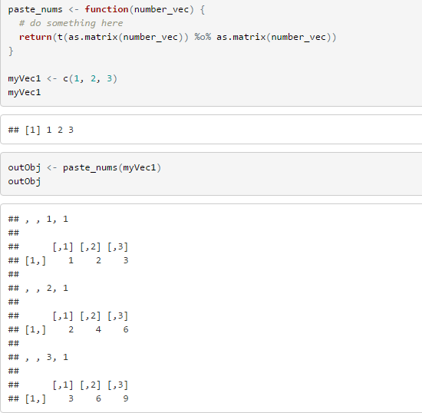
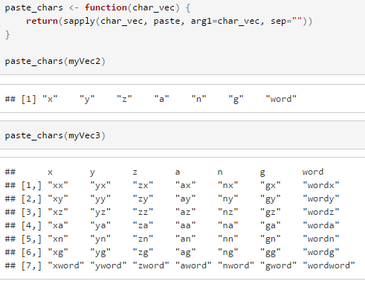
Matrix Math
It is believed that this one is not used as much but we will start with outer product
This R code helps illustrate an outer product
Note that it takes the outer product of a simple vector treated as a matrix and cross-multiplied with itself)

Slide 7
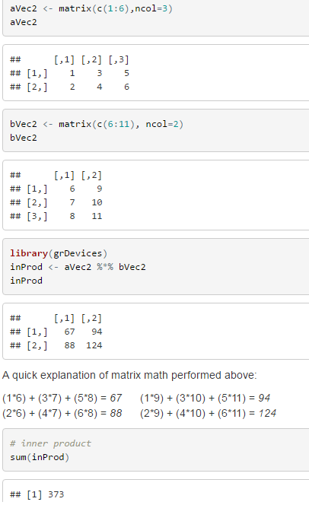
Matrix Math
Inner Products are more common in statistical analysis. In R, `%*%` functions as the operator for inner product calculations.
This code again multiplies two vectors of different dimensions together. As per the name, the “inner dimensions” cancel out and the final vector retains the outer dimension:
dimensions (2 x 3) dot dimensions(3 x 2) = dimensions(2 x 2)
Note: the inner dimensions must match or the inner product cannot be calculated.
In this calculation 2 rows x 3 columns is combined with 3 rows x 2 columns. 3’s cancel and we are left with 2 x 2.
The outers do not have to match. If 3 x 3 were “dotted into” 3 x 2, we would get a matrix of 3 x 2 to sum up for the final answer.
You will hear inner product and “dotting” or “calculating the dot product” used interchangeably for this operation.

Slide 8
More Terms and Concepts
Supervised / Unsupervised Learning:
“Supervised” – there is a response variable to relate to each observation of the predictors which “supervises” the analysis. In short, most of what we think of as standard statistical analysis (or “classical statistical learning methods”) falls into this category and analysis can take the form of linear/logistical regression (classical), and also: GAM, Boosing, SVM (support vector machines) (all listed as more modern approaches)
“Unsupervised Learning” -- No response variable to “Supervise” the results and in some respects is likened to “flying blind”. Descriptions talks about a vector to relate back to x rather than y where y is a response variable. Clustering analysis is an example of unsupervised learning. This can apply to market segmentation.
“semi-supervised learning” – this may be oversimplifying, but this can relate to incomplete data where we have response variables for some but not all and are looking to combine the two techniques to some degree.

Slide 9
More Terms and Concepts
Quantitative / Qualitative (categorical): Typical expectations
Quantitative (numerical) responses are expected in linear regression problems
Qualitative (categorical) responses are expected in categorical problems

Slide 10
More to Come …
More concepts will be explored in these slides as I find the time to add them

